Slide 1
UI Design: Friday Week 1
Dr. Jillian Aurisano
Plan for today:
Reminders, course logistics
Intro user centered design
Needs finding / requirements gathering
Concrete tasks vs essential goals
One method: interview
Do an interview activity
Notes:
So welcome to engineering visual interfaces for data science. I'm Dr Aurisano.
Thanks for finding the class on Zoom. Hopefully we will be in person again soon.
If anyone out there is comfortable turning on their cameras, that is lovely- then I feel like I am talking to students, rather than to myself.
Here’s our plan for today:
First I’m going to introduce myself, so you know a bit about me
Then we are going to get to know each other, in Zoom breakout rooms. This will give us a chance to make sure that Zoom breakout rooms work, and we all know how to access them.
Then, I am going to walk through the structure, and plan for the course. I want to make sure everyone knows how the course will work, and what to expect, and also a bit about why the course is designed this way.
Then I am going to introduce the class, and what the class is about. Since this is a new class, and one of just a few classes in human centered computing here at UC, I wanted to give an overview of the topic.
Then I have an introductory activity, which we will do in breakout rooms, and which I think will help motivate the discussion on Wednesday, and getting into the meat of the class.

Slide 2
Course updates
Hw1 a and b due Tuesday
Next Wednesday- extra coding help if needed.
Also can post to discord
Project 1 questions?
Next week- bring paper, sketch pads, pencils or tablets!
We will be sketching!

Slide 3
What is usability?
Usability is an attribute that assesses how easy user interfaces are to use

Slide 4
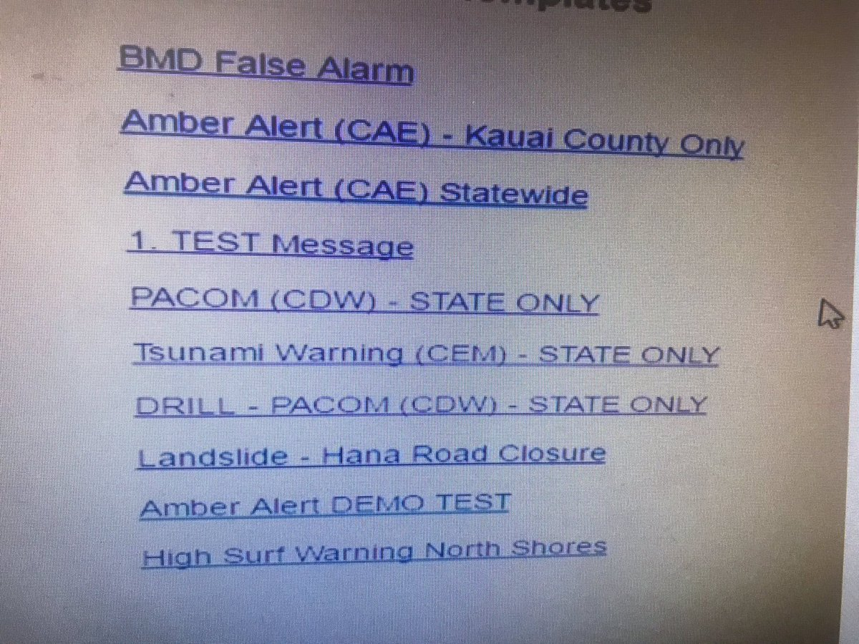
Hawaii threat system UI- Not Usable ----> Result: Disastrous Error

Slide 5
What process was used to make this?

Slide 6
What process was used to make this?
System focused-
here are the current features
(current alerts)
New feature is made (new alert)
Add another button

Slide 7
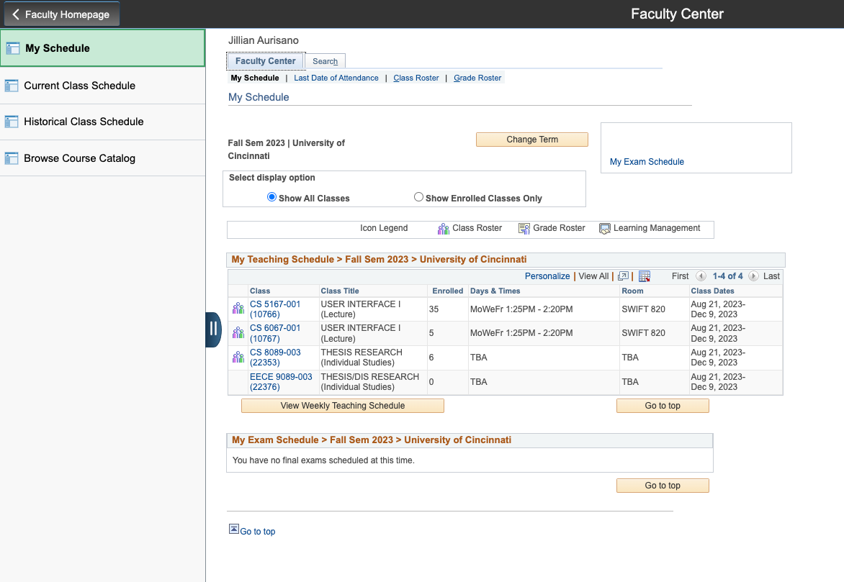
Another example
What process produced this?

Slide 8
Another example
List of requirements
Must be able to see list of courses
Must be able to select the course
Must be able to see students in the course
…..
System restrictions (has to communicate with registrar)

Slide 9
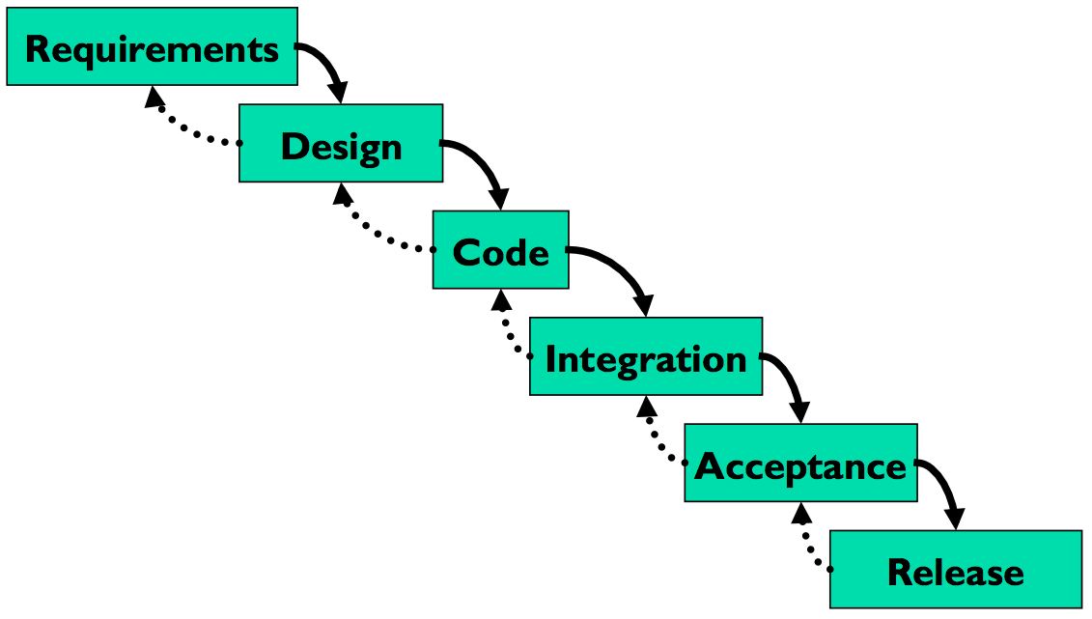
Traditional software development process
Waterfall model
Anyone encountered this in class before?
Can you describe it?
Is this a good model for user-centered design?
Where is the user?

Slide 10
Not enough user engagement in the process
User only included in the first step: capturing requirements and the last step- acceptance and release
Users not integrated throughout the process
Can lead to an application that doesn’t meet their needs

Slide 11
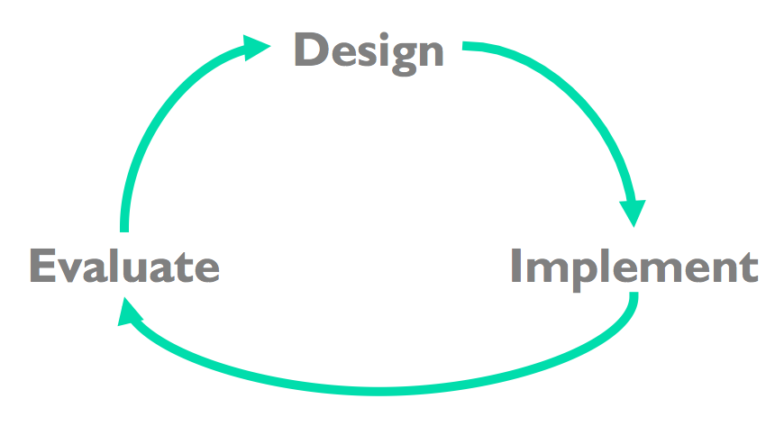
Hence, User-Centered Design is iterative
Iterative design
Early focus on users and tasks
Constant evaluation to inform new design choices
Evaluation with lightweight prototypes
We will get into this but first….

Slide 12
How do we enter the cycle?
Needs finding, understanding our users

Slide 13
Entering the cycle: Needs finding
Learning about the user, and their needs, so you can address their needs in your design
We need to understand our users
Who are they?
What are their goals?
What should the design help them do?
We are going to discuss ways to capture this, and potential pitfalls

Slide 14
Step 1: Your users: who are they?
User profiling
Things to learn
Age, gender, culture, language
Education (literacy? numeracy?)
Physical limitations
Computer experience (typing? mouse?)
Motivation, attitude
Domain experience
Application experience
Work environment and other social context
Relationships and communication patterns with other people
Pitfall
describing what you want your users to be, rather than what they actually are
“Users should be literate in English, fluent in spoken Swahili, right-handed, and color-blind”

Slide 15
Step 1: Your users: who are they?
User profiling
Capturing or generating profiles of potential users, to characterize them
Pitfall: describing what you want your users to be, rather than what they actually are
“Users should have prior experience with similar interfaces”

Slide 16
Step 1: Your users: who are they?
There can be multiple classes of user
Primary users, Secondary users
Or other divisions (expert users, novice users….)
These distinctions can help you think about different sets of goals, or different expectations or levels of experience

Slide 17
Step 2: User needs and goals
Capture what your user needs to do (Their tasks) and what they want to accomplish with the interface (their goals)
Not about systems requirements (yet)
Not about design of the UI (yet)
All about what people need
Methods:
Observation (we will cover later….)
Surveys (we will discuss later…)
Interviews- we will begin working on today

Slide 18
Are these user needs and goals?
Suppose you are designing an appointment app.
You start by writing down ideas:
Have a data structure to store appointments, which contains the date, time, location
Set-up a monitoring function that will be called every hour, to notify users of any upcoming appointment.
A bell will ring to notify the user of an appointment
Are these user needs and user goals?

Slide 19
Pitfall in design: Skipping the user
Pitfall: Begin with the system you want to build
Have a data structure to store appointments, which contains the date, time, location
Set-up a monitoring function that will be called every hour, to notify users of any upcoming appointment.
These may reflect a need from the user.
How would we word these as user needs?

Slide 20
Pitfall in design: Skipping the user
Pitfall: Begin with the system you want to build
Have a data structure to store appointments, which contains the date, time, location
Set-up a monitoring function that will be called every hour, to notify users of any upcoming appointment.
These may reflect a need from the user.
How would we word these as user needs?
User need: “I need to know about my appointments, so I don’t miss them”

Slide 21
Pitfall in design: Skipping the user
Pitfall: Begin with UI design goals
UI design idea: A visual pop-up will alert the user, and a system bell will ring to notify them about an appointment
These may reflect a need from the user.
How would we word these as user needs?

Slide 22
Pitfall in design: Skipping the user
Pitfall: Begin with UI design goals
UI design idea: A visual pop-up will alert the user, and a system bell will ring to notify them about an appointment
These may reflect a need from the user.
How would we word these as user needs?
User needs first: I need to be alerted in a way that it can be detected by me even if I am not looking at a device or paying close attention to the calendar

Slide 23
Why does this matter?
What happens if you start from these:
Have a data structure to store appointments, which contains the date, time, location
Set-up a monitoring function that will be called every hour, to notify users of any upcoming appointment.
A visual pop-up will alert the user, and a system bell will ring to notify them about an appointment
And not these:
I need to know about my appointments, so I don’t miss them
I need to be alerted in a way that it can be detected by me even if I am not looking at a device or paying close attention to the calendar

Slide 24
Beginning with the user needs will
Focus on the user from the beginning, design the system around their needs
Instead of building around a system or data structure or a design choice first
Provide an opportunity to explore a variety of design and system solutions
I need to ….
Lots of potential solutions to user needs
(Next week we will talk about how to explore alternatives)

Slide 25
How can we do need finding?
Observation (we will learn some methods later)
Surveys (we will discuss later)
Interviews- we will begin working on today
(Note- interviews and observations can ALSO be used for evaluation….)

Slide 26
What is an interview
Discussion with someone of interest (e.g., potential user)
Verbal
May be :
Full structured- list of defined questions, no deviation from questions
Semi-structures- a list of questions, but can follow-up with new questions based on response
Unstructured- no planned questions, just a conversation
Interviews and focus groups can be similar, but solo vs in a group

Slide 27
Needs finding: User Interviews
Goal:
learn something new – not confirm something
be open to changing your ideas and plans
develop a specific list of needs, that you will use to ideate design alternatives
How:
Word questions in ways that are open, non-judgmental, not leading to a particular solution, but that will help you learn something

Slide 28
Important distinction: Concrete tasks vs essential goals
Sometimes users may express something they want. Ask yourself:
is this based on what they currently do?
-> Concrete task they typically perform
is it based on a need
-> Essential goal / need
Example:
User : ”I need to save the file to disk” (Concrete task)
Need: I need to preserve my work. (Essential goal or need)
Why does this matter?

Slide 29
Important distinction: Concrete tasks vs essential goals
Sometimes users may express something they want. Ask yourself:
is this based on what they currently do?
-> Concrete task they typically perform
is it based on a need
-> Essential goal / need
Example:
User : ”I need to save the file to disk” (Concrete task)
Need: I need to preserve my work. (Essential goal or need)
Why does this matter?
As before, be open to alternate solutions not based on current practices
What might we come up with instead??

Slide 30
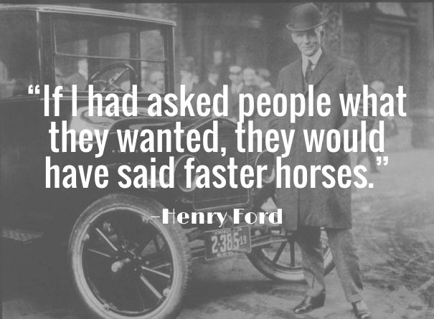

Slide 31
Need finding pitfall: Expecting the users to tell you what to design
You can’t just ask the users what you should be designing
“Would you like the interface to have a popup with a sound to alert you?”
What might happen if you ask this?
Instead:
Ask about their goals
Ask about their problems
Ask about their experiences
Ask them what they need to get done
Any ideas for how to ask a broader question, to get at their needs?

Slide 32
Take note:
User analysis is different than market analysis
Not- will users use my product
Not- is there a market for this product
Not- what will people pay
These are important questions, but often approached with different techniques

Slide 33
What is the end result?
Readable and clear, documented set of user needs that informs the design
Users need to plan around scheduled appointments.
They express that they often want to know about appointments at different times, depending on the appointment type: a week in advance, a day, a few hours, a few minutes…
They want to be reminded just in time
They may not be looking at their phones and don’t want to miss the reminders
Needs should be expressed at a level of detail which is appropriate for leaving room for alternative design exploration (within the frame established by the needs)

Slide 34
How to write these needs?
AVOID: user sees a pop-up asking to register, he enters username and password, click on submit and the pop-up close, showing a page with the top navigation bar and in the center a dashboard with all the personalized information displayed in a grid metaphor….
AIM FOR:
What user needs to do ultimately: The users’ goal is to access their assignments and lecture notes, so they can keep up in their class
What problems do they face: The user struggles to find what they need, and it delays their work
What do they want?
The users wants to have personalized info in the app, saved for every time they use it
User needs to be able to see their high priority tasks quickly as soon as they start using it, and not have to scroll through lots of options
User wants to have it be a familiar layout, without too many options
….

Slide 35
User needs? User requirements?
I prefer to use the language of user needs, so we stay open to solutions.
User needs
Translate into design and system requirements

Slide 36
Activity: Lets try to do an interview
First planning- let’s plan a semi-structured interview
Then we will go into small groups and interview each other
And then reflect
How to write interview questions?
Not too many

Slide 37
Interview Guidance: how to do it
Attitude:
AIM FOR: Learning, understanding, identifying, discovering, unveiling, clarifying ( open to change)
AVOID: confirming, demonstrating, re-assuring, achieving consensus, discussing opinions ( closed to change)
Key test of a good user interview:
What are 3-4 things you have learned that you did not know before
Focus your questions on the experience
Not projection, prediction, extrapolation, “thoughts”
NO: Do you like this application? Do you like keeping track of your sleep?
YES: Tell us about your experiences using this <thing>? Tell us about your experiences getting enough sleep?

Slide 38
Interview Guidance: how to do it
Non-judgmental attitude: Do not convey in any way that you are expecting a certain answer…
NO:
Don’t you think this feature would be better if available also as an iPad application?
What do you love about tracking your sleep?
YES:
Is there any other way you’d like to use a feature like this in your current work? How? Why?
How do you feel about tracking your sleep? What is the experience like?
Check your question for a bias- does it express a preference in it? Can you re-write it? Let’s try:
Did you like using the smart editing suggestions feature?
Would you like to see this have a connection to a smart watch?

Slide 39
User interview guidance
Keep each question focused on a single topic. Avoid using AND / OR in your questions (linking more statements together)
NO: How would you use this app at school or at work, for example?
YES:
How would you use this app at school?
How would you use this app at work?
Provide a way out from your options
What do you often use to get the news? Smartphone or tablet? Or something else?
Even in close-ended questions, give the possibility of expressing things outside the available options
NO: which of the following feature is most important to you? [what if no one is important?]
YES: Rate from 1 to 5 how important each feature is for you, where 1 is least important, 5 is most important. Put 0 if a feature is irrelevant for you.

Slide 40
User Interview Guidance
Avoid binary questions
Do not force black/white commitments on the “whole”
Elicit “analytical” feedback on specific elements
NO: Is this product useful?
YES: What, if anything, do you find useful about this product? Why?

Slide 41
Let’s give it a try
First plan interview questions
Then we will practice

Slide 42
2. Presentation and reflection
What went well?
What was difficult?
Did you learn something?
What would you do differently if doing this interview again?

Slide 43
3. Reconvene groups, and use the interviews to identify user needs
ID user needs:
Record the needs and problems and goals you captured from your interviews
Look back over the initial brainstorming and think about what needs you were addressing in your initial ideas, incorporate them
Create a list from these needs that will help us do design alternatives next week
Specific + problem focused, rather than solution focused
The user wants to be able to understand ….
The user has trouble with ….
The user should be able to ….
Ok to note disagreements- some users want to be able to …. Others want ….

Slide 44
4. Present

